Slide 1
Pathology as a Career
Michael R. D. Koch, M.D
Department of Pathology

Slide 2
Pathology as a Career
Pathology Residency Statistics
  2015 Match Data
    141 Pathology Residency Programs in the U.S. plus one in Puerto Rico
    605 PGY-1 positions available in 2015 match
    97% of U.S. medical students matched*
    24 unfilled PGY-1 positions after the match
      All filled in secondary match
    8 U.S. medical students didn’t match

Slide 3
Pathology as a Career
Pathology Residency
  Most complete a four year AP/CP residency
    American Board of Pathology (ABP) recognizes a physician-scientist research pathway to certification. Generally combine a two-year accelerated AP or CP residency with a guaranteed fellowship and postdoctoral position
    The ABP also recognizes a four-year combined AP/neuropathology pathway

Slide 4
Pathology as a Career
Pathology Residency
  USD Sanford School of Medicine Pathology Program
    Oldest, continual residency program in South Dakota
    Started in the early 1960’s
      Dr. Barry Pitt-Hart first graduate
    48 graduates to date
      14 practice in South Dakota
      17 practice in the Upper Midwest

Slide 5
Pathology as a Career
Pathology Residency
  USD Sanford School of Medicine Pathology Program
    10 funded resident positions, typically have 7-10 residents in the program at any one time
    Generally offer 2 residency positions each year
    Excellent success on ABP board exams
      100% of residents have passed the exam
    Excellent success with acceptance to fellowships
      100% success rate for residents applying for a fellowship

Slide 6
Pathology as a Career
Pathology Residency
  USD Sanford School of Medicine Pathology Program
    Two training sites
      Sanford Health Pathology Clinic
      Sioux Falls VA Medical Center
    12 faculty members
      Faculty specialty training
        Blood banking, hematopathology, dermatopathology, cytopathology and breast pathology

Slide 7
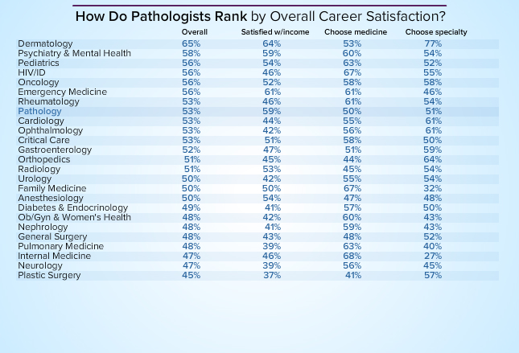
Pathology as a Career

Slide 8
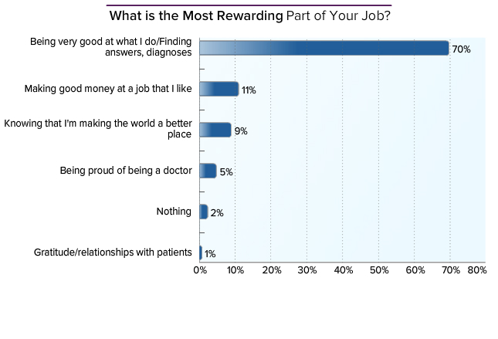
Pathology as a Career

