Slide 1

Welcome to our Department of Internal Medicine
My journey
Your journey
Our Department
10 Major Divisions
Access to our Divisions
Matching System Blocks in Pillar 1 to Specialists in Pillar 2-3

Slide 2
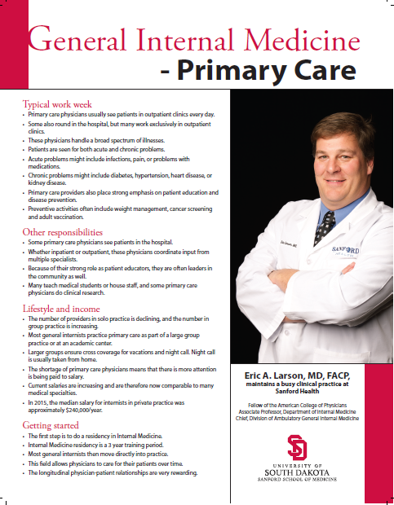
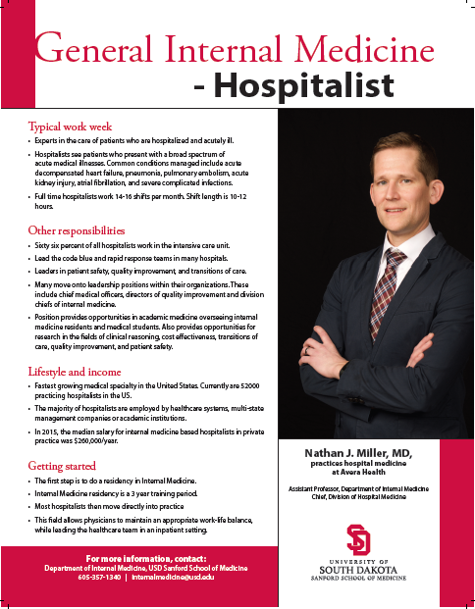
Welcome to our Department of Internal Medicine

Slide 3
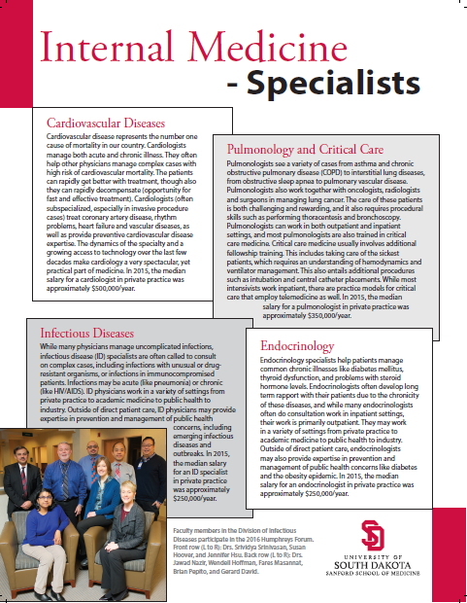
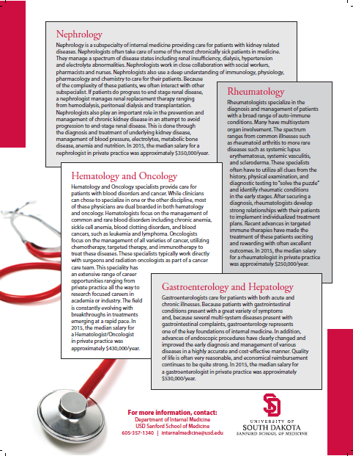
Welcome to our Department of Internal Medicine

Slide 4




My Journey…

Slide 5
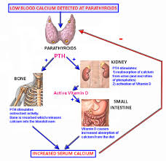
My Journey…

Slide 6
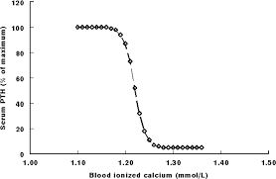
My Journey…

Slide 7
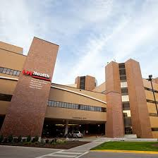



My Journey…

Slide 8

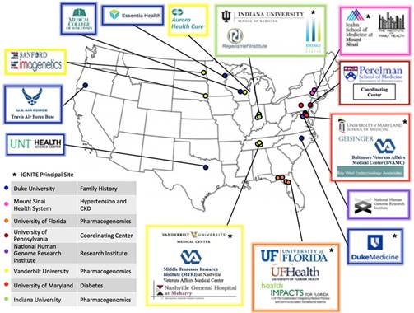

Slide 9
Your Journey…

Slide 10

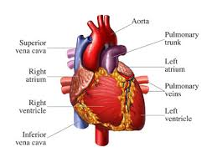
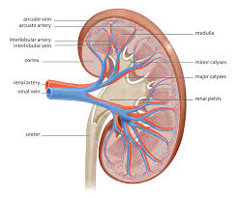
Your Journey…

Slide 11
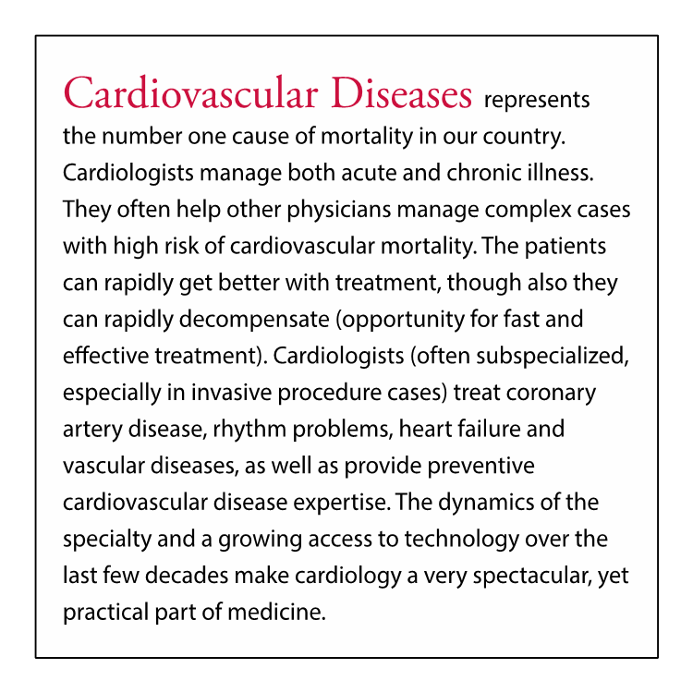
Your Journey…

Slide 12

Your Journey…

Slide 13
Major Divisions in Internal Medicine
- Primary Care (GIM)
- Hospital Medicine
- Cardiology
- Dermatology
- Endocrinology
- Gastroenterology
- Geriatric Medicine
- Hematology/Oncology
- Infectious Diseases
- Nephrology
- Pulmonology
- Rheumatology
65 Electives Available in Clinical Years

Slide 14
CLERKSHIP GUIDE TO SPECIALISTS (DEPT of IM)
DIVISION | CHIEF | COORDINATOR: SF - SANFORD | COORDINATOR: SF - AVERA | COORDINATOR: RAPID CITY | COORDINATOR: YANKTON
GIM- OUTPATIENT | Dr. Eric Larson | Dr. Candace Zeigler | Dr. Scott Hiltunen | Dr. James Bowman | Dr. Tyler Hanson
 |  | Stephanie.Rieck@sanfordhealth.org | Janet.Wollman@avera.org | thite@regionalhealth.com | 605-665-7841
 |  | 605-328-7516 | 605-782-8329 | 605-755-3300
GIM- OUTPATIENT | Dr. Nathan Miller | Dr. Randall Lamfers | Dr. Nathan Miller | Dr. Shahid Ahmad | Dr. Beth Mikkelsen
 |  | Kris.Nelson@sanfordhealth.org | Katie.Bruns@usd.edu | pmorgan1@regionalhealth.com | 605-668-8000
 |  | 605-328-4973 | 605-357-1364 | 605-755-8894
CARDIOLOGY / CCU | Dr. Adam Stys | Dr. Adam Stys | Dr. Paul Carpenter | Dr. Jose Teixeira | Dr. Will Hurley
 |  | Darla.Fjerstad@sanfordhealth.org | cvoeltz@ncheart.com | mermish@regionalhealth.com | 605-665-7841
 |  | 605-312-2253 | 605-977-5000 | 605-755-4300
DERMATOLOGY | Dr. Brian Knutson | (appointment pending) | Dr. Brian Knutson | Dr. Gregory Wittenberg | Dr. James Young
 |  | recruitment in process | Bryan.Haan@avera.org | mschweppeme@rcmed.net | 605-655-7841
 |  |  | 605-322-6971 | 605-342-3280
ENDOCRINOLOGY | Dr. Ajaz Banka | Dr. John Palmer | Dr. Ajaz Banka | (appointment pending) | (appointment pending)
 |  | Amanda.Saeger@sanfordhealth.org | Chantelle.McCoy@avera.org | recruitment in process | recruitment in process
 |  | 605-328-8143 | 605-322-7617
GASTROENTEROLOGY | Dr. Jorge Gilbert | Dr. Jorge Gilbert | Dr. Cristina Hill Jensen | (appointment pending) | Dr. Stephen Gutnik
 |  | Deborah.Skaff@sanfordhealth.org | Rebecca.Washnok@avera.org | recruitment in process | 605-665-7841
 |  | 605-328-8511 | 605-322-8631
HEMATOLOGY/ONCOLOGY | Dr. Michael McHale | Dr. Jonathan Bleeker | Dr. Michael McHale | Dr. Joshua Lukenbill | Dr. Mary Villanueva
 | Dr. Jonathan Bleeker | Cassie.McClure@sanfordhealth.org | Michael.McHale@avera.org | 605-755-2301 | 605-665-7841
 |  | 605-328-8628 | 605-322-6900 & ask for Dr. McHale
INFECTIOUS DISEASES | Dr. Jennifer Hsu | Dr. Jennifer Hsu | Dr. Brian Pepito | (appointment pending) | Covered by Telemedicine
 |  | Margaret.Kropuenske@sanfordhealth.org | Karla.Ludwig@avera.org | recruitment in process | Avera.org/ecare
 |  | 605-328-8438 | 605-322-7250
NEPHROLOGY | Dr. Larry Burris | Dr. Larry Burris | Dr. Arvin Santos | Dr. Louis Raymond | Dr. Byron Neilsen
 |  | Stacy.Weller@sanfordhealth.org | Pat.Sivesind@avera.org | kvollmer1@regionalhealth.com | 605-665-7841
 |  |  | 605-322-5806 | 605-755-3327
PULMONOLOGY / ICU | Dr. Debbie Qua | Dr. Debbie Qua | Dr. Eyad Kawar | (appointment pending) | Dr. Lori Hansen
 |  | Debbie.Qua@sanfordhealth.org | Laurie.Koerner@avera.org | recruitment in process | 605-665-1152
 |  | 605-328-8900 | 605-322-6938
RHEUMATOLOGY | Dr. Joseph Fanciullo | (appointment pending) | Dr. Joseph Fanciullo | Dr. Jennifer May | Dr. Leann Maska-Bassing
 |  | recruitment in process | Kathy.Miles@avera.org | 605-755-3300 | 605-665-1722
 |  |  | 605-322-6644

Slide 16
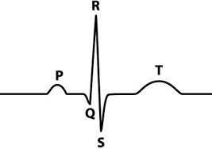
Major Divisions in Internal Medicine

Slide 17
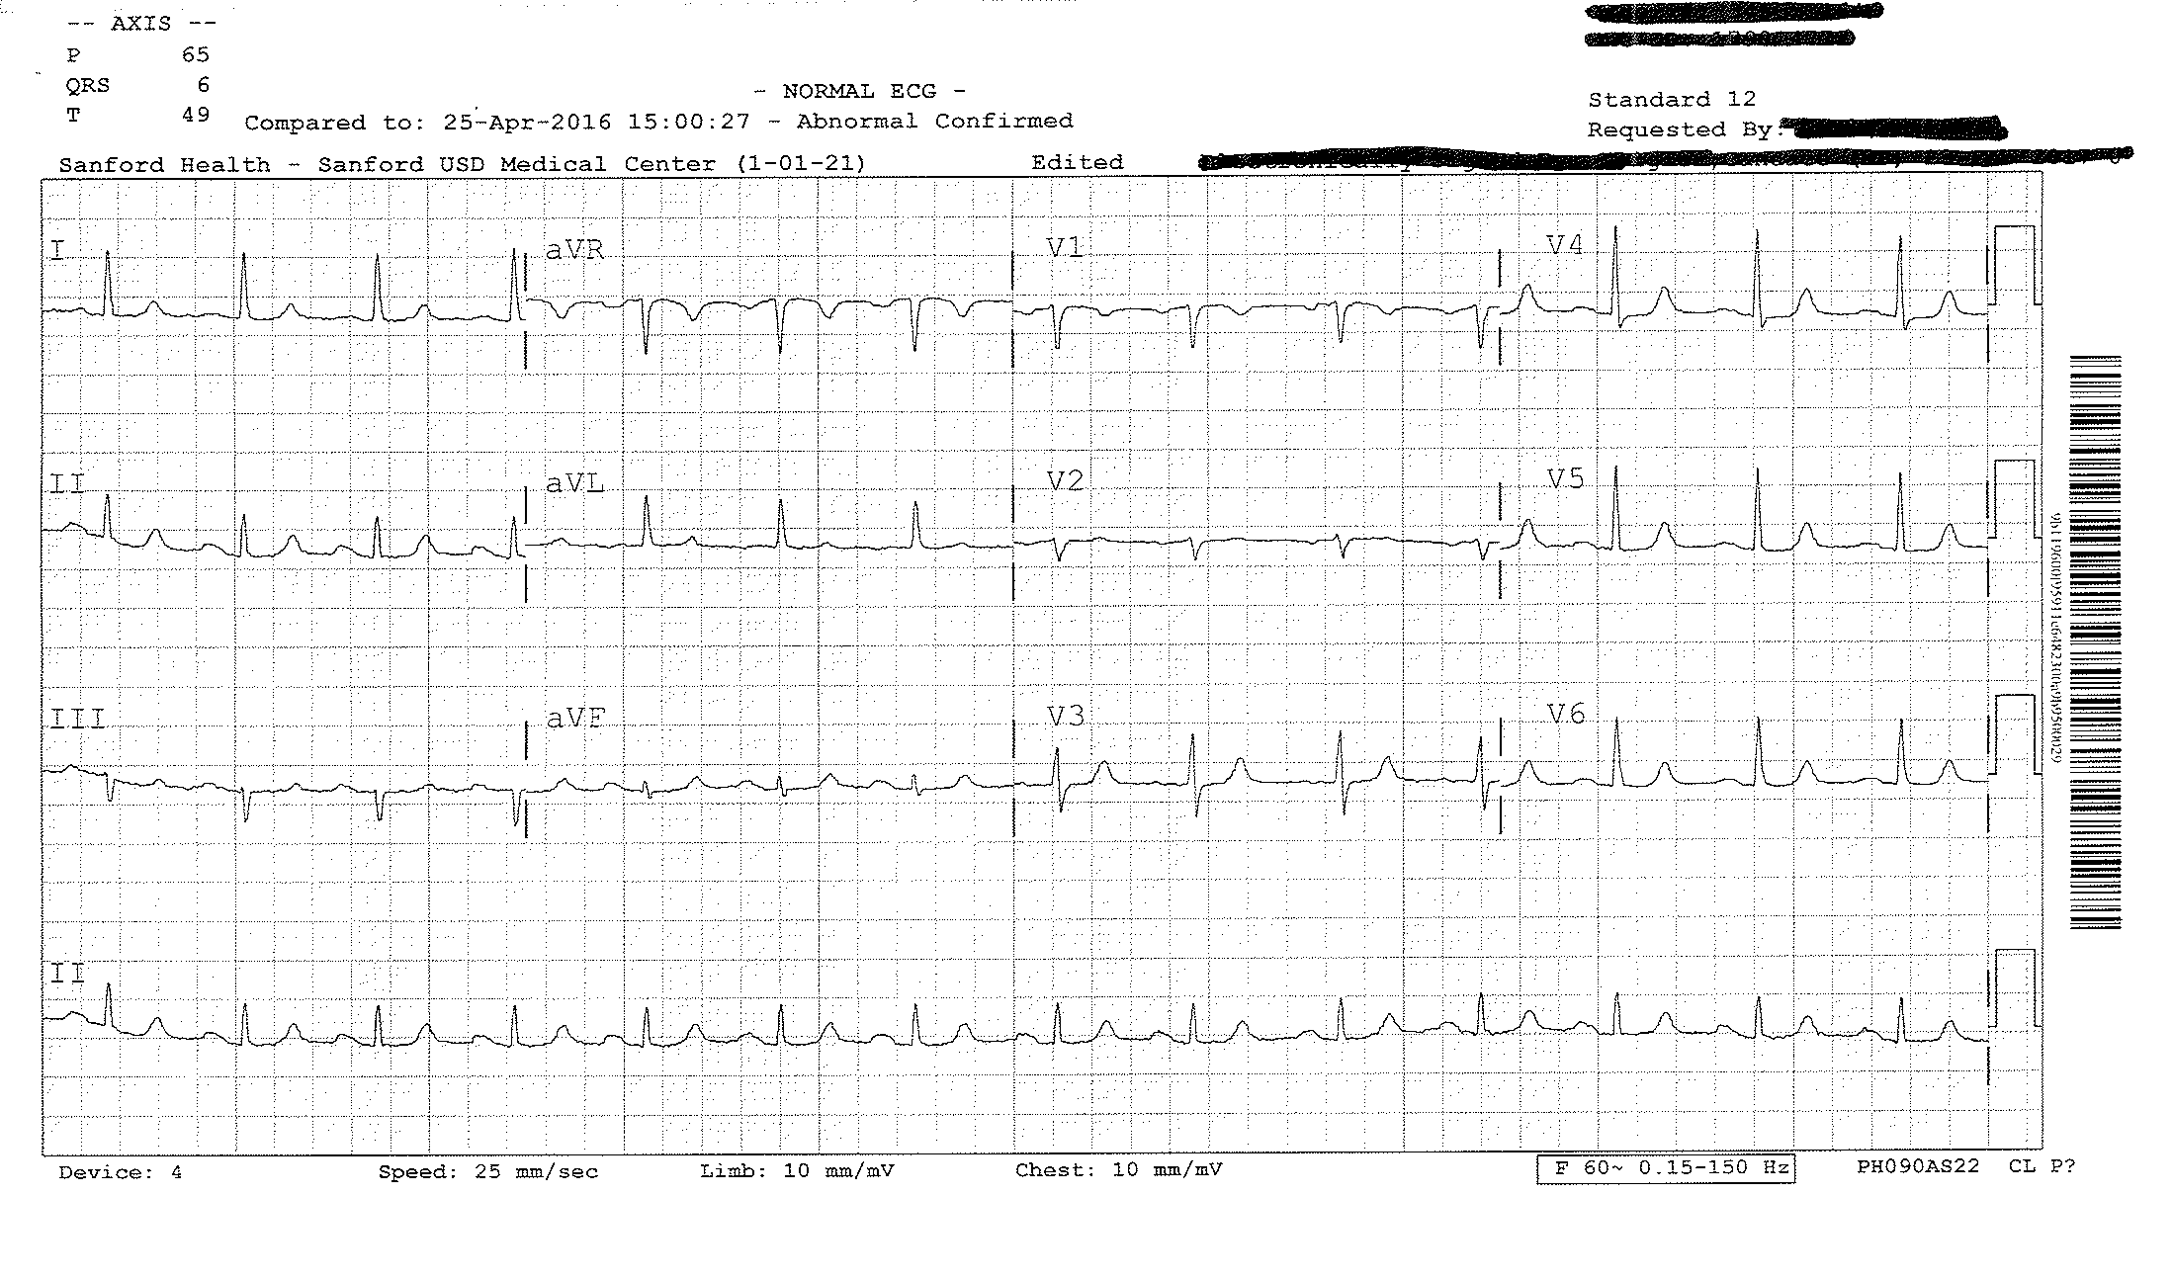
Normal EKG

Slide 18
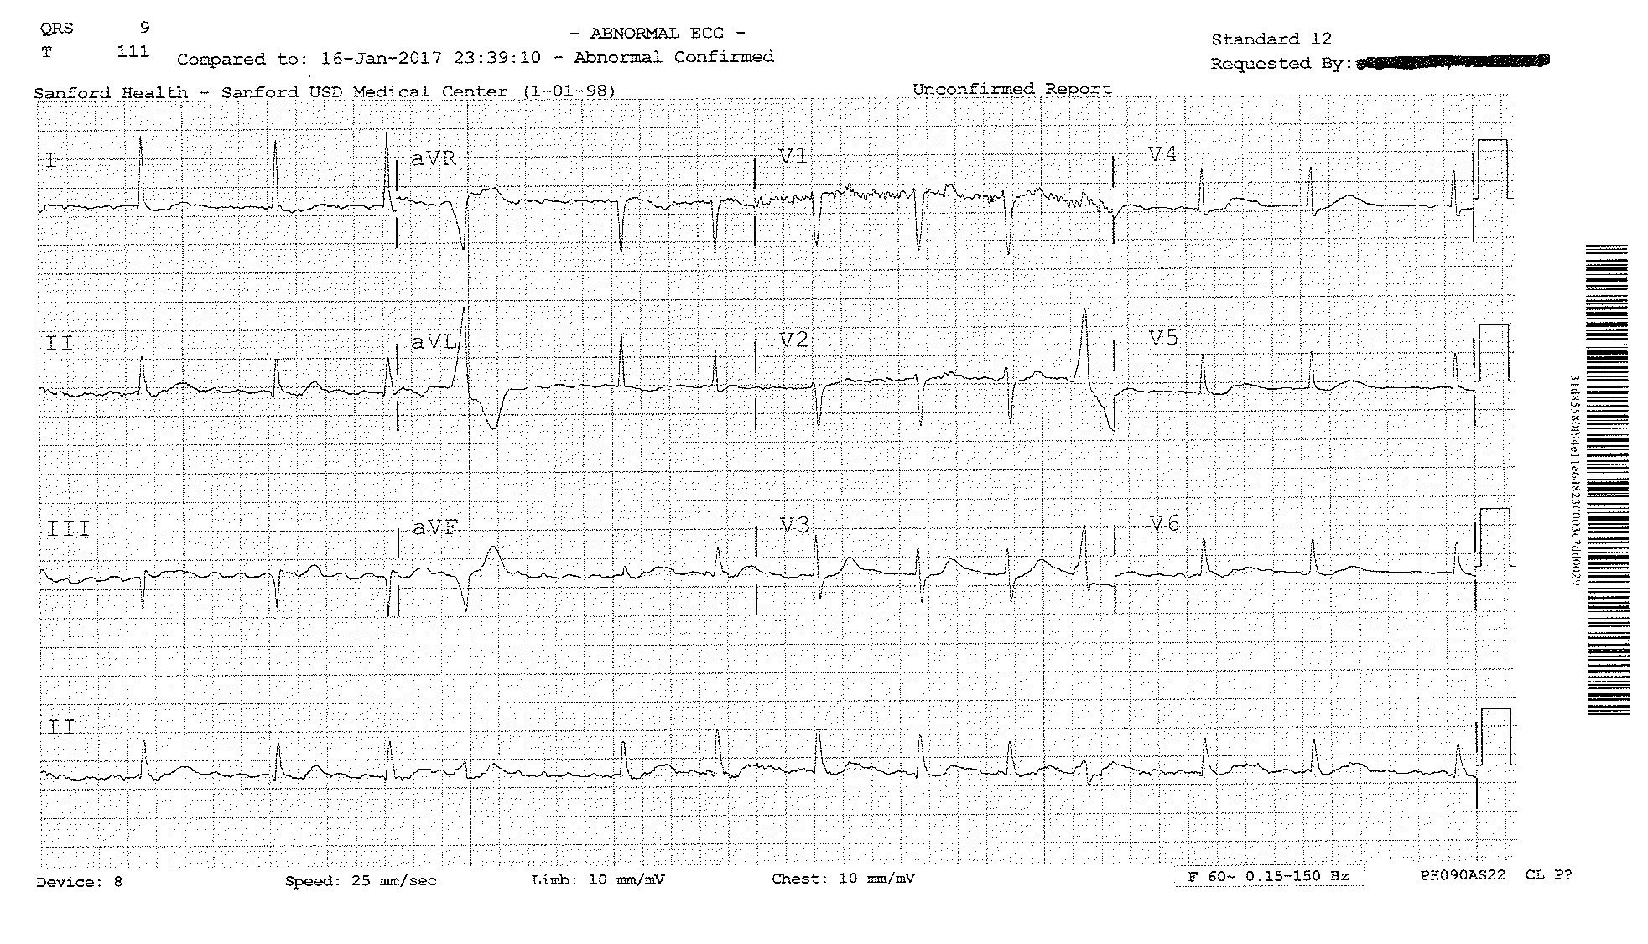
Abnormal EKG

