Slide 1

Welcome to the Department of Internal Medicine
Our Department
Primary Care IM
Hospital Medicine
12 Major Divisions
Access to our Divisions
Matching System Blocks in Pillar 1 to Specialists in Pillar 2-3

Slide 2
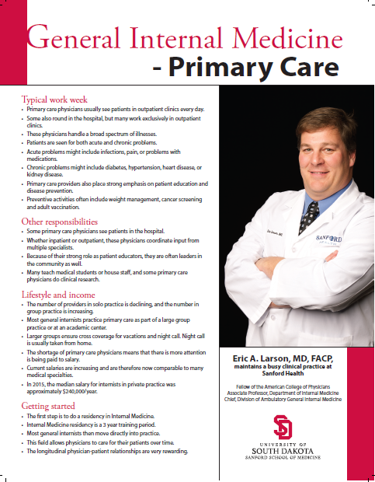
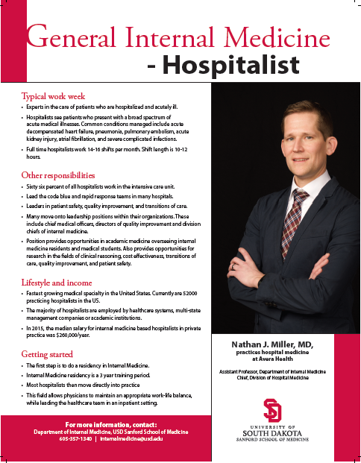
Welcome to the Department of Internal Medicine

Slide 3
Welcome to the Department of Internal Medicine
Internal Medicine Residency ( 3 years )

Slide 4
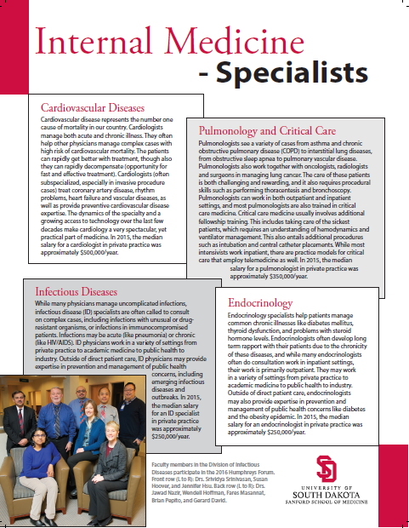
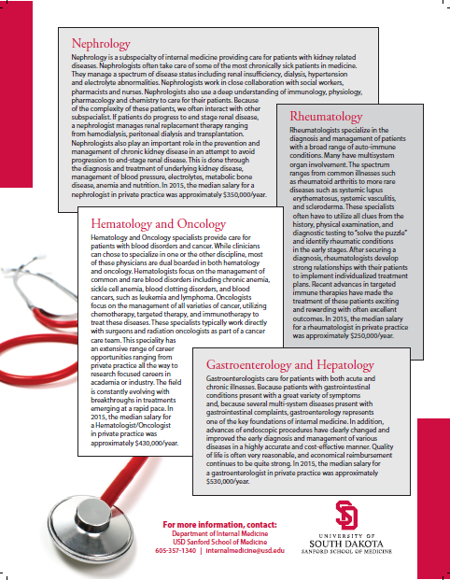
Welcome to the Department of Internal Medicine
Additional Fellowship Training ( 2 - 5 years )

Slide 5
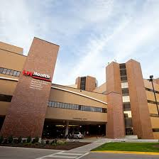
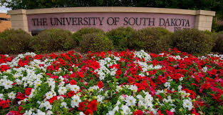
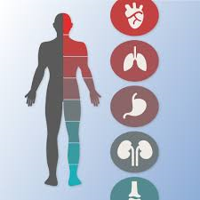

My Journey…

Slide 6




My Journey…

Slide 7
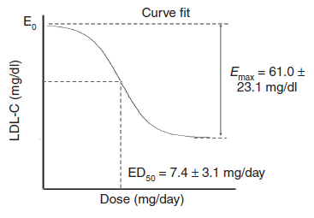
My Journey…

Slide 8
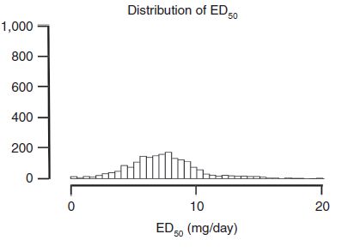
My Journey…

Slide 9
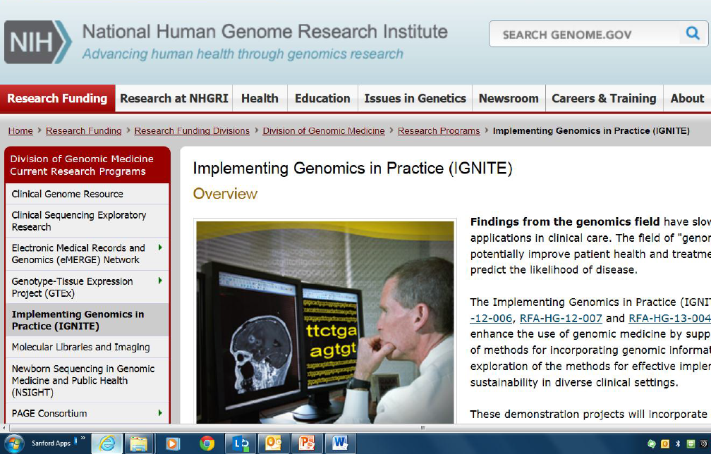
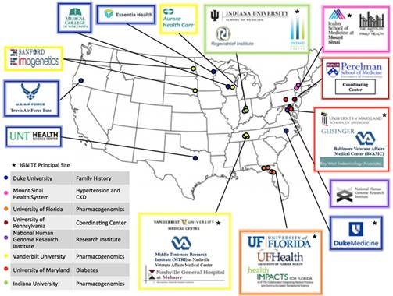

Slide 10
Major Divisions in Internal Medicine
- Primary Care (GIM)
- Hospital Medicine
- Cardiology
- Dermatology
- Endocrinology
- Gastroenterology
- Geriatric Medicine
- Hematology/Oncology
- Infectious Diseases
- Nephrology
- Pulmonology
- Rheumatology
65 Electives Available in Clinical Years

Slide 11
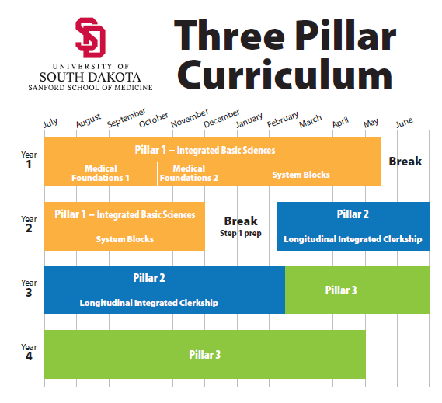
Your Journey…

Slide 12
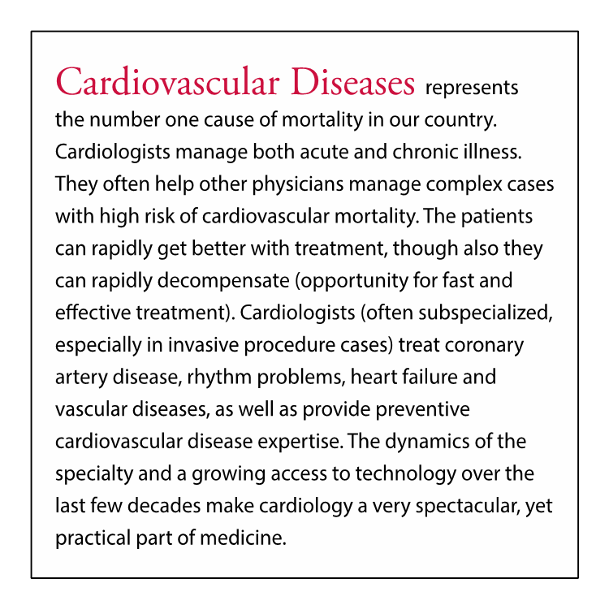
Your Journey…

Slide 13
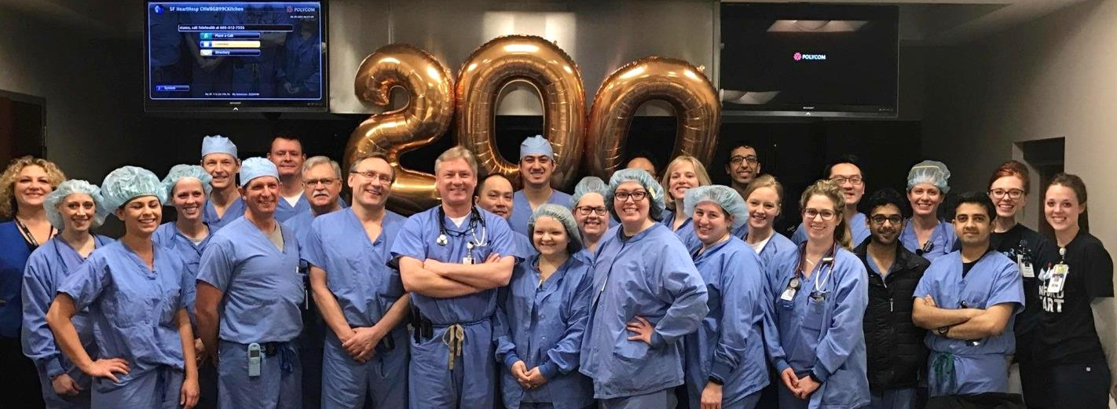
Division of Cardiology
Department of Internal Medicine

Slide 14
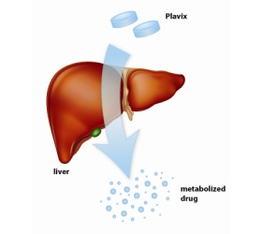
clopidogrel (Plavix) is activated in the liver
pro-drug
active drug
metabolite

Slide 15
~1 in 4 patients have an abnormal gene for this enzyme
clopidogrel (Plavix) is activated in the liver
pro-drug
active drug
metabolite

Slide 16
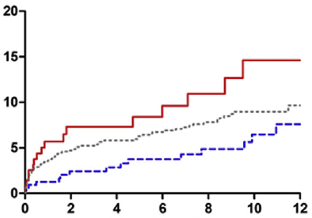
loss of function
cardiovascular events
normal gene(s)
time on clopidogrel (months)
Journal of the American College of Cardiology 2017

Slide 17
cardiovascular events
switch drug
time on clopidogrel (months)
Journal of the American College of Cardiology 2017

