Slide 1
PACE Palette
USD Women in Science Education Day
September 29th, 2016
Notes:
Personal and Company Effectiveness
(4 – most like you) (1 – least like you)

Slide 2
Personal And Company Effectiveness
Life changing
Informative and fun
Increase your understanding of
  Yourself
  Your co-workers
  Your family
  Even people you don’t know
Notes:
Hippocrates (Father of Western Medicine) – 4 distinct temperament patterns (optimistic, irritable, analytical, peaceful)
Myers-Briggs and other behavioral experts (introvert vs extrovert; feeling vs thinking; sensing vs intuition; perceiving vs judging)
PACE is more fun and easier to apply to everyday use

Slide 3
BENEFITS OF PACE
Personal insights
Increase effective communications with others
Build stronger teams

Slide 4
Spontaneous Impulsive Impetuous | Stable Methodical Planner | Cooperative Idealistic Sincere | Rational Curious Complex
Adventurous Daring Hurried | Traditional Responsible Dependable | Faithful Compassionate Inspirational | Logical Analytical Loner
Loves excitement Explorer Unpredictable | Dutiful Teacher Industrious | Authentic Empathic Motivator | Intellectual Inventive Problem Solver
Energetic Expedient Jokester | Makes Rules Orderly Well-prepared | Supportive Self-aware Caring | System-Thinker Independent Perfectionist
Bold Witty Risk-taker | Loyal Reliable Likes Structure | Romantic Flexible Kind | Theoretical Ingenious Individualist

Slide 5
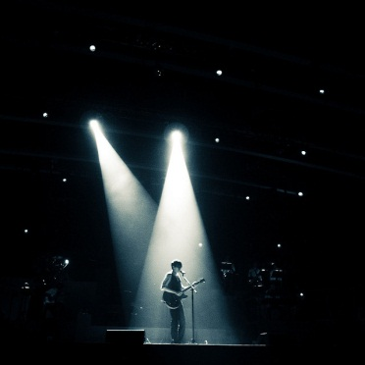

RED - ADVENTURE
Free to do things my own way​
I want to explore​
Where is the action?? I want a part of it!​
Impulsive behavior​
I love the spotlight - watch me perform!
Notes:
Spontaneous

Slide 6


YELLOW - RESPONSIBILITY
I value rules, tradition, and authority​
I handle details well​
Structure and order are very important​
Strong urges to plan my work and work my plan​
I anticipate and prepare for the future

Slide 7
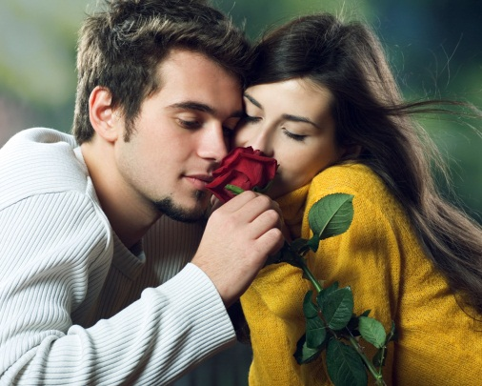
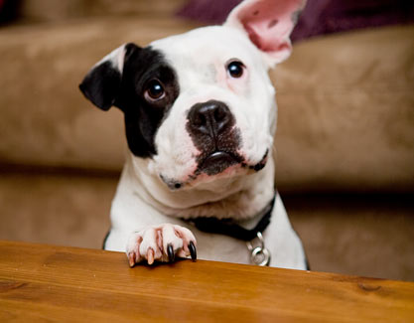
BLUE - HARMONY
Relationships are important to me​
I have lots of friends - human AND furry​
I embrace emotions​
I'm caring, intuitive and a great listener​
I enjoy flowers, music, romantic movies, and nature

Slide 8
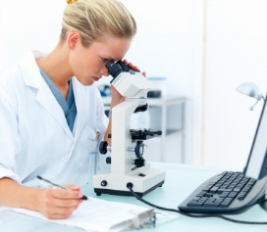
GREEN - CURIOSITY
I love puzzles, problems, and finding solutions​
My calm exterior may hide some inner turmoil​
I enjoy research and reading manuals​
Analyze, study, invent, investigate, and explore​
I want my brain to manage my emotions

Slide 9

Notes:
Break into groups!

Slide 10
JOYS, VALUES AND STRENGTHS
What is really important in life?
What activities give you joy and pleasure?
What are your natural talents?
What do you do well?
  In professional life?
  In personal life?

Slide 11
IRRITATIONS, AGGRAVATIONS, AND STRESSORS
What things bother you as a group?
What do people do that bug you?
What stresses you in your professional and personal lives?
What makes you angry? Impatient? Sad?

Slide 12
What’s Your Office Like?
RED –
  Adventurous photos, trophies
  Cluttered and informal
Yellow –
  Certificates of accomplishment
  Neat and organized
Notes:
One of my partners – I can’t sit in his office well as there are too many books and papers on the chairs and this “yellow” gets really uncomfortable sitting there.

Slide 13
What’s Your Office Like?
Blue –
  Certificates won by team effort
  Happy, informal family pics
  Warm environment
Green –
  Latest in computer equipment, gadgets
  Stacks of work, highlighted manuals
  Will know exactly where everything is
  Not real comfy for visitors
Notes:
Waltz – super user for Epic --- I always visit with him while he sits in his office chair and I am standing in the doorway.

Slide 14
Breakdown
40% Reds
40% Yellows
15% Blues
5% Greens

Slide 15
Don’t fit completely into one color?

Slide 16
Second Color as a Modifier
YELLOW – BLUE: A person who likes structure, planning, and neatness and loves people
GREEN – RED: Someone who wants to find all the right answers and is willing to venture for them

Slide 17
Second Color as a Modifier
GREEN – BLUE: A person with a lot of curiosity; loves to solve problems and have people around
RED – BLUE: This person loves to adventure with people. They stay in touch with kids they went to school with and are ready to visit them now!

Slide 18

Second Color as a Modifier
BLUE – RED: A person who loves people and wants to contribute to others but will be aggressive when they see cruelty or unfairness

Slide 19
CELEBRITIES AND THEIR COLORS
Batman – RED
Abby on “NCIS” – GREEN BLUE
Ducky on “NCIS” – GREEN
Donald Trump - ?
Notes:
Abby (goth) - forensic scientist
Ducky (quirky) – pathologist and medical examiner

Slide 20

Final thoughts?

Slide 21
Questions to consider….
A typical day for me…
What I do for fun…
My pet peeves are…
Things that derail me at work….
Things that derail me at home…

