Slide 1


Transitioning to a New Role: Practical Tips on Navigating From One Chapter to the Next
Archana Chatterjee, M.D., Ph.D.
Professor and Chair, Department of Pediatrics
Senior Associate Dean for Faculty Development
University of South Dakota Sanford School of Medicine

Slide 2









“Not in His Goals but in His Transitions man is great” - Emerson
?


Slide 3
Background

Slide 4
Change vs. Transition – Change is Easy, Transition Hurts!
From “Managing Transitions” by William Bridges. Available at http://www.moravian.org/wp-content/uploads/2013/06/Bridges_Transition_Model.pdf

Slide 5

Why People Change Roles
Get recruited/asked to take on new role
Figure it is time to change
How many of you:
Have Transitioned Recently?
May Transition in the Near Future?

Slide 6

Select AAMC Faculty Forward data from 2011

Slide 7
Factors that predict
Intent to Leave
Nature of work - 83%
Collegiality + Collaboration - 72%
Relationship with supervisor - 70%
Focus on medical school mission - 67%
Workplace Culture - 67%
Faculty Recruitment + Retention - 63%
Compensation + Benefits - 62%
Medical school governance - 45%
Select AAMC Faculty Forward data from 2011
*Items in red font are designed to draw the attendee’s attention to them
Notes:
Items in red font are designed to highlight importance and draw the attendee’s attention to them

Slide 8
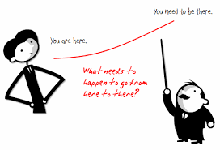
Objectives
Identify need/opportunity for transition
Prioritize tasks associated with leaving a position and institution
Describe strategies to enhance knowledge of the new organization and establish priorities
Establish goals to be accomplished early
Avoid common pitfalls
Describe methods of building new collaborative relationships and effective teams

Slide 9

OBJECTIVE #1
Identifying Need/Opportunity

Slide 10

Strategies to Identify Need/Opportunity Where are the “Hot Jobs”?
Small group/dyad discussion – Within Institution vs. External
5 minutes
Report to larger group

Slide 11

Strategies to Identify Need/Opportunity
Where are the “Hot Jobs”?
Are you happy in your current position?
  If not, look for opportunities – Within Institution vs. External
Engage your network
Let trusted people know you may be willing to transition to a new position/role
When asked to serve in a new role – SAY YES (If it is the right fit for you)!
Connect with search firms
  Typically hired by organizations to fill leadership positions
  Some specialize in placing leaders in academic medicine
  Helpful in identifying the right position for you and preparing you for interviews

Slide 12

OBJECTIVE #2
Prioritizing Tasks

Slide 13

How Would You Prioritize Tasks?
Write down 3 things you would do
5 minutes
Report back

Slide 14

Leaving Gracefully (and with Integrity)
Create a Transition Plan
Make a TO DO list
  Professional
  Personal
Develop a Time Table (and stick to it!)
Announce departure/new position
Activate succession plan/delegate duties
Notes:
Items in red font are designed to highlight importance and draw the attendee’s attention to them

Slide 15

1) What to Include in a Transition Plan
Offer to write/modify a job description
Offer to help recruit/suggest successor
Prepare staff/colleagues
Offer to provide training/support for replacement
  Create list of responsibilities
  Index paper/electronic files
  Share “insider tips”

Slide 16

2) Things to include on a TO DO List
Professional
  Apply for medical licensure/credentialing
  Arrange to transfer grants
  Meet with HR – Benefits, vacation, etc.
  Complete/hand off projects/charts, etc.
  Clear up files – paper/electronic
  Allow time to pack/organize office, lab., etc.

Slide 17
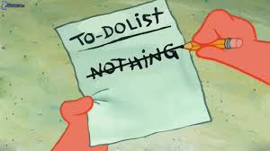
2) Things to include on a TO DO List (cont.)
Personal
Prepare/Engage your family/friends – this often plays a large role in women’s decision to transition
Arrange for school, bank transfers, mail forwarding, etc.
Allow time to pack/organize
Schedule a vacation
Allow time to reflect on past, plan for future
Notes:
Items in red font are designed to highlight importance and draw the attendee’s attention to them

Slide 18
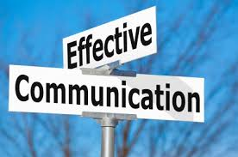
3) & 4)Timetable/Communications
Develop a realistic timetable
Allow for “cushion”
Create/deliver/rehearse notification of resignation/ transition
Meet key stakeholders
Notify patients/collaborators/friends/relatives
Prepare/deliver “farewell” message
  Emphasize the positive
  Thank everyone (not a time to vent/gloat!)
  Bid goodbye
Notes:
Items in red font are designed to highlight importance and draw the attendee’s attention to them

Slide 19

5) Succession Plan/Delegation
Allow sufficient time for transition
Clarify work expectations during transition
Be flexible on timelines
Keep end date in mind
Suggest appropriate successor
Mentor successor if possible
Offer future support (with realistic expectations)
Notes:
Items in red font are designed to highlight importance and draw the attendee’s attention to them
Create a bright line for yourself if transitioning within inst.

Slide 20

OBJECTIVE #3
Learning the New Culture

Slide 21
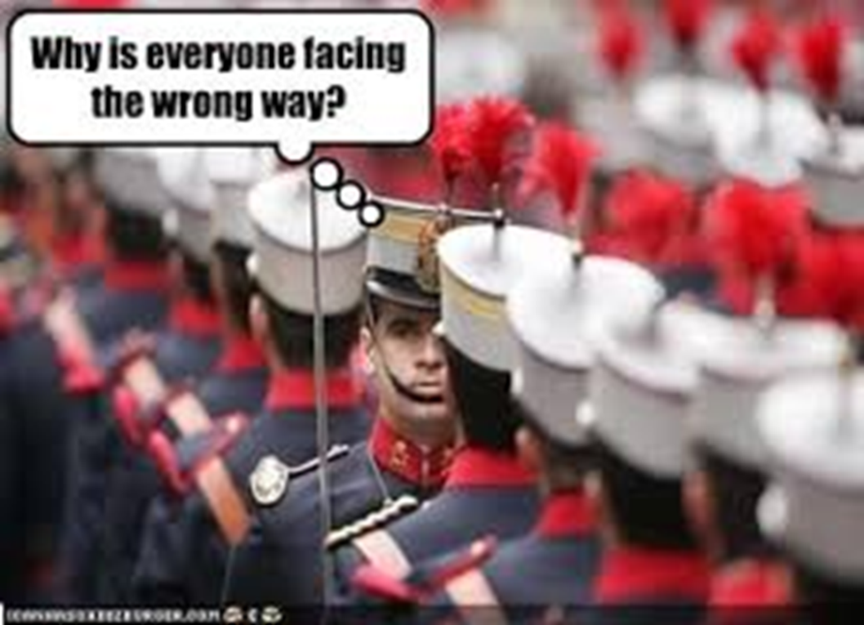



What is “culture” and how do I learn it?
Notes:
Culture Eats Strategy for Breakfast – Peter Drucker

Slide 22
Definition of “Culture”
The behaviors and beliefs characteristic of a particular group
OR
“How we do things around here” – Dr. Kevin Grigsby
Notes:
Items in red font are designed to highlight importance and draw the attendee’s attention to them

Slide 23
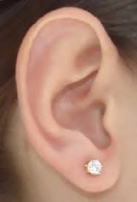
Knowledge of New Organization
Learn Organizational Culture – websites, publications/reports, key stakeholders, discussion with colleagues, utilize Linked In profiles to search for networks
Situation Analysis - Understand Mission, Org. Chart, history and traditions, decision-making process
Start “listening tour”
Discuss with predecessor/interim person – issues, priorities
Conduct stakeholder interviews
Engage a Mentor/Coach
Connect with Admin staff – Schedule “Unscheduled” Time
Notes:
Items in red font are designed to highlight importance and draw the attendee’s attention to them

Slide 24

OBJECTIVE #4
Establishing Priorities/
Goals

Slide 25

How Would You Establish Priorities?
Write down 3 things you would do
5 minutes
Report back

Slide 26

Establishing Priorities/Goals
Priorities
  Yours – “A” items
  Your boss’s – urgent vs. longer-term
  Others’
Develop “Milestones”
  First week
  First month
  First quarter
  First year
}
“Low-hanging Fruit”

Slide 27
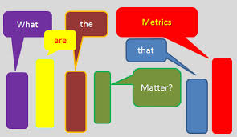
Establishing Priorities/Goals (cont.)
Analyze own strengths, weaknesses, learning style – take time to pause, question, reflect
Build Personal Credibility/Trust – Define strategic intent, connect with people, “early wins”
Demonstrate Authenticity – create transparency, show loyalty, confront reality, keep commitments
Delineate Outcomes/Metrics for Success – clarify expectations, practice accountability
Articulate Vision and Goals - Be a change agent (respectfully)
Create the role, don’t just fill it!
Notes:
Items in red font are designed to highlight importance and draw the attendee’s attention to them

Slide 28

OBJECTIVE #5
Avoiding Common Pitfalls

Slide 29

What are Common Pitfalls and How Would you Avoid Them?
Write down 3 common pitfalls during a transition
Write down 3 ways to avoid these
5 minutes
Report back

Slide 30

Common Pitfalls
Overpromising/Underdelivering – “Human beings are overconfidence machines” – David Brooks, NY Times
“Selective” listening
Falling out of alignment with leadership
Trying to orchestrate change without support
Being inflexible
Poor communication
Underestimating resources needed to accomplish goals
Notes:
Items in red font are designed to highlight importance and draw the attendee’s attention to them

Slide 31

Common Pitfalls (cont.)
Failure to understand/adapt to organizational culture
Failure to establish strategic priorities
Inadequate “face time” – with peers, subordinates, boss
Hubris - Arriving with “the answer”
Over-reliance on old strategies
Tyranny of the “Urgent”
Conspiracy of Interruptions
Failure to build team
Notes:
Items in red font are designed to highlight importance and draw the attendee’s attention to them

Slide 32

Strategies for Avoiding Common Pitfalls
Enlist trusted observer
Keep vision in sight – plan for demands of new job, esp. time
Continuously self-assess
Let go of the past
Hit the ground running
“See” yourself in new role
Relearn how to learn
Rework your network – go to “them”
Do not over-rely on strengths
Watch out for “underminers”
Notes:
Items in red font are designed to highlight importance and draw the attendee’s attention to them

Slide 33

OBJECTIVE #6
Building New Relationships and Teams
See “Strategies for Cultivating Career Satisfaction and Success through Negotiation” available at https://www.aamc.org/download/439462/data/toolkit-negotiations.pdf

Slide 34

How Would You Build New Relationships/Teams?
Small group/dyad discussion
5 minutes
Report back

Slide 35

Building Relationships and Teams
Assemble/solidify team
Assess your “team”
  ? Right mix of skills
  ? Right team dynamic
  ? Right organizational support
Keep “good” people
May need to restructure – tough early calls
Foster collaboration
Create supporting alliances and coalitions
May need formal team-building exercises/consultant
Notes:
Items in red font are designed to highlight importance and draw the attendee’s attention to them

Slide 36

“Takeaways”
Transition NOT the same as change
Preparing to leave takes time and planning
Learning ASAP/AMAP about new position critical to success
What worked before may not work again
Communication is key
A thoughtful approach will help prevent pitfalls
Team-building is vital and takes time and energy
Notes:
Items in red font are designed to highlight importance and draw the attendee’s attention to them
ASAP = As soon as possible
AMAP = As much as possible

Slide 37

Additional Resources
Watkins, MD. Picking the right transition strategy. Harvard Business Review, 2007.
Watkins, MD. The First 90 Days: Proven Strategies for Getting Up to Speed Faster and Smarter, Updated and Expanded, 2013.
Goldsmith, M. What Got You Here Won't Get You There: How Successful People Become Even More Successful, 2008.
Ciampa D, Watkins M. Right From The Start: Taking Charge In A New Leadership Role, 2005.
Katzenbach JR and Smith DK. The wisdom of teams.
Lencioni P. The five dysfunctions of a team.

Slide 38

Additional Resources
Bickel J. Deciphering the organizational culture and developing political savvy. Academic Physician & Scientist, 2005.
Morahan P. Traversing career changes gracefully. Academic Physician & Scientist, 2002.
Grigsby K. Five ways to fail as a new leader in academic medicine. Academic Physician & Scientist, 2010.
http://www.kornferryinstitute.com
http://www.cvdtraining.pitt.edu/docs/Johnson2009_Essays.pdf

Slide 39
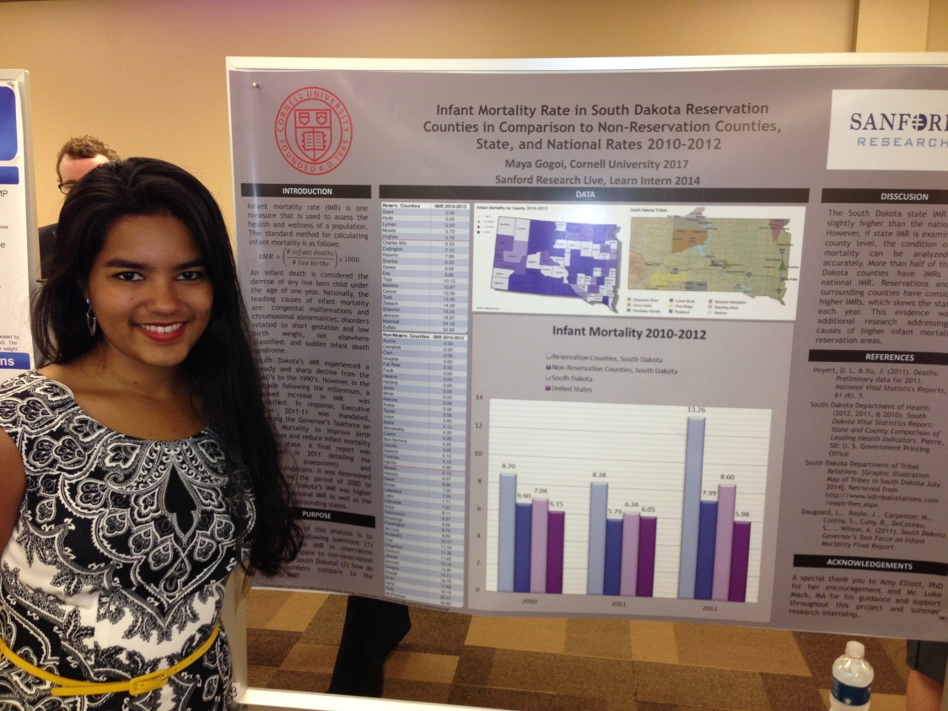
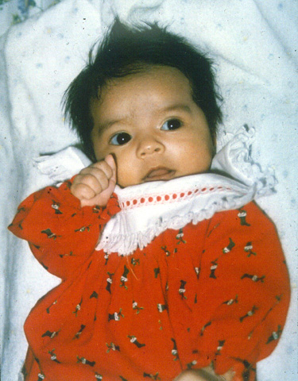

Slide 40


